Slide 1
Equipment Services

Slide 2




BREAD OVEN & PROFFER
MODEL : NVT 3/9
SPEED TOASTER
MODEL : ENCORE
EQUIPMENT Serviced by MIDDLEBY
MICROWAVE OVEN
MENUMASTER
Notes:
2

Slide 3



BREAD OVEN & PROFFER
MODEL : 6/18
SPEED TOASTER
MODEL : E4s
EQUIPMENT Serviced by Western/ Merrychef
Hoshizaki Chiller Freezer
Ice Machine
Notes:
3

Slide 4


Ice Machine
Manitowac E 30
Electrolux Chiller / Freezer
EQUIPMENT Serviced by Wang
Notes:
4

Slide 5
Front Counter and SS fabrication
EQUIPMENT Serviced by Aster
Notes:
5

Slide 6
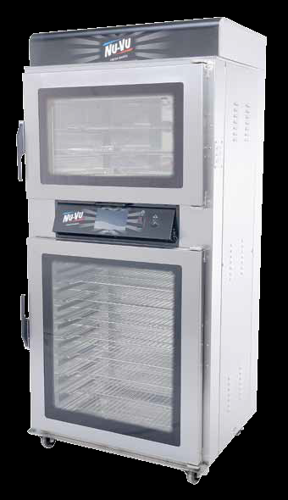
Pre – Installation Requirements for Duke / Nu-Vu Bread oven & Proofer
Input Electric supply
415v , 3 phase , 50 HZ , 20 amps circuit breaker , 5 core cable with proper grounding terminal if its 3 phase unit.
230v , 1 phase , 50 HZ , 40 amps circuit breaker , 3 core cable with proper grounding terminal if it is 1 phase unit & Neutral to Ground terminal voltage would be less than 1 volt.
Stabilizer should be provided if the Incoming voltage fluctuation beyond + / - 5 volt.
Water Supply
waterline is required for proofer. Minimum water pressure specifications
for the 1/4” pipe size water connection with 30 psi pressure.
Clearance
Need minimum six inches on each side and back of unit and front side for door open Oven - 35-5/8” • Proofer - 35-5/8”.
WATTAGE:
OVEN: 5000 • PROOFER: 1200
DIMENSIONS:
Height Width Depth :- Exterior : 77-3/4” 36-1/2” 30-3/4” --- Interior :- Oven 14-1/2” 26” 18-1/2” Proofer 33-3/8” 26” 18-1/2”

Slide 7
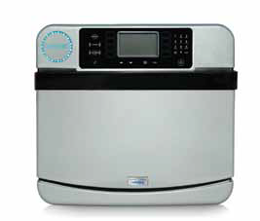
Pre – Installation Requirements for Merrychef / Turbochef speed oven / Toaster
Input Electric supply
400v , 3 phase , 50 HZ , 20 amps circuit breaker , 5 core cable with proper grounding terminal if its 3 phase unit.
230v , 1 phase , 50 HZ , 30 amps circuit breaker , 3 core cable with proper grounding terminal if it is 1 phase unit & Neutral to Ground terminal voltage would be less than 1 volt.
Stabilizer should be provided if the Incoming voltage fluctuation beyond + / - 5 volt.
WATTAGE:
6.7 KW + 3.5 KW ( MW )
Clearance
Need minimum 6 inches on each side and back of unit & front side for door open 10”.to 12”
Dimension :-
Height 19” 483 mm , with legs 23” 584 mm
Width 21.4” 544 mm , Depth (footprint) 28.6” 726 mm , with door closed 32.7” 831 mm , with door open 39.4”

Slide 8
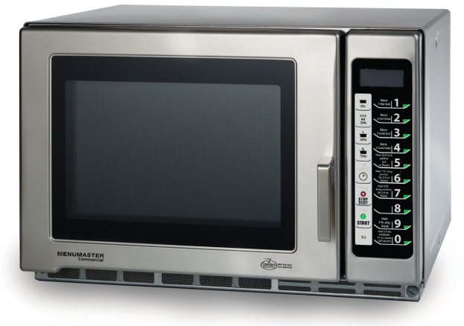
Pre – Installation Requirements for Menu master Microwave toaster – RFS511TSW
Input Electric supply
230v , 1 phase , 50 HZ , 20 amps circuit breaker , 3 core cable with proper grounding terminal if it is 1 phase unit & Neutral to Ground terminal voltage would be less than 1 volt.
Stabilizer should be provided if the Incoming voltage fluctuation beyond + / - 5 volt.
WATTAGE:
3000 WATTS , 230 VOLT , 13 AMPS
MW : 1100 WATTS
Clearance
Need minimum 6 inches on each side and back of unit & front side for door open shall be 12 to 15” approximately.
Not Stackable and do not keep any item / unit in top the oven .
Dimensions
Cabinet : Width 21 3/4" 55 cm 21 3/4" 55 cm , Height 14 1/4" 36.2 cm 14 1/4" 36.2 cm , Depth 20 1/4" 51.4 cm 20 1/4" 51.4 cm
Oven Interior
Width 14 1/4" 36.2 cm 14 1/4" 36.2 cm , Height 9" 22.6 cm 9" 22.6 cm , Depth 16 3/8" 41.6 cm 16 3/8" 41.6 cm

Slide 9
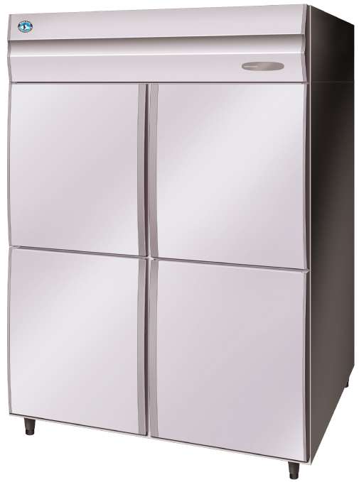
Pre – Installation Requirements for chiller Freezer: Hoshizaki / Electrolux
Input Electric supply
230v , 1 phase , 50 HZ , 20 amps circuit breaker , 3 core cable with proper grounding terminal if it is 1 phase unit & Neutral to Ground terminal voltage would be less than 1 volt.
Stabilizer should be provided if the Incoming voltage fluctuation beyond + / - 5 volt.
Clearance
Need minimum 6 inches on each side and back of unit & front side for door open shall be 12 to 15” approximately.
Selves not be stacked 100% , This will block the air circulation and will impact the working of the equipment
WATTAGE:
600 Lts - 600 WATTS , 230 VOLT , 15 AMPS
1300 Lts - 1000 WATTS , 230 VOLT , 15 AMPS
Dimensions
700 ltr Cabinet : Width 70 cm , Height - 81 cm, Depth 205 cm
1300 Ltrs Cabinet : Width 140 cm , Height - 81 cm, Depth 205 cm
Please note : Warranty Term and Policy without proper rated servo Stabilizer with proper spacing and shelves stacking the Warranty is Null and Void. Further, any Service Request without replacement of Spare Parts is chargeable, Like cleaning of Condenser chocked due to Dust. Consumables , spare parts and services will be chargeable.

Slide 10
Pre – Installation Requirements for Ice machine : Hoshizaki / Manitowac
Input Electric supply
230v , 1 phase , 50 HZ , 20 amps circuit breaker , 3 core cable with proper grounding terminal if it is 1 phase unit & Neutral to Ground terminal voltage would be less than 1 volt.
Stabilizer should be provided if the Incoming voltage fluctuation beyond + / - 5 volt.
¾” water Inlet Point with RO Water Supply within 02 FT. of the Machine, with Pressure Minimum- 1.4 Bar, Max 5.5 bar
Portable watrer temperature – 10-30 celsius.
Drainage Point at Floor Label.
WATTAGE:
800 WATTS , 230 VOLT , 15 AMPS
Clearance
Need minimum 6 inches on each side and back of unit & front side for door open shall be 12 to 15” approximately.
3.5 KVA individual Stabilizer within 02 FT. from the Machine .
Dimensions
Manitowac Cabinet : Width 450 cm , Height - 65 cm, Depth 475 cm
Hoshizaki Cabinet : Width 400 cm , Height - 700 cm, Depth 510 cm
Please note : Warranty Term and Policy without proper rated servo Stabilizer with the Machine and RO Water Supply for the Machine the Warranty is Null and Void. Further, any Service Request without replacement of Spare Parts is chargeable Like cleaning of Condenser chocked due to Dust, Spares chocked due to Water scaling and Reset the Machine due to non availability of incoming Water. Consumables , spare parts and services will be chargeable.

Slide 11
Some of the Challenges at the Restaurant/ Franchisees
Factors below causing operational problem and risk uptime of equipment at the store. This also causes high cost of repair.
Voltage / Frequency fluctuations. Large equipment’s are sensitive or intolerant to high voltage fluctuations. These ovens are rated for operating at 415 V in 3 phase & 230 V in Single phase, whereas in India, with varied geography, the voltage received varies from 300-475 V in 3 phase & 170-280 V in Single phase. Also, frequency varies from 40Hz to 70Hz, against 50 Hz rated by equipment manufacturers. Thus, without a AVR the equipment is bound to fail.
Unauthorized Repairs – Stores indulges, to get repairs / troubleshooting done locally by a neighborhood electrician or a “freelancing” technician from the equipment suppliers for economic reasons. More often this eradicate the symptom but do not solve the issues to avoid future cost. Service providers have come across attempts to repair ovens and toasters, this can solve issue temporarily, but will cause for a bigger problem with respect to uptime and repair bill in future.
Age of equipment: It is experienced that, breakdowns are on higher side with the aging of equipment, depending how it is being used and maintained at the store.
Avoiding Annual Maintenance – To maintain high Uptime of these equipment’s, it is advised to have a AMC from the approved service providers.

Slide 12
Pre – Installation Requirements – Servo Stabilizers
Servo stabilizer installation would help franchisee to save guard expensive equipment’s at their restaurants.
A three phase servo stabilizer which is able to set output in the range of 400V /415 V± 5%, 50Hz if the unit need 3 phase power supply OR 230V ± 5% ,50 Hz if the unit configured to work in Single phase. That means, The output terminal must be 5 terminals like L1, L2, L3, N , GND.), with voltage selector switch in the Input & output of the servo stabilizer. So that there is flexibility to select the required voltage depends upon the site Input power condition / configuration of the oven.
To support franchisees, IPCA has explored vendor M/s. Consul for servo stabilizers for franchisees consideration. The type and capacity of servo stabilizer for your store, would depend upon :
Capacity of stabilizer would depend upon Equipment's and lighting fixtures franchisee would want to have stabilized at the restaurants. The commercial stabilizers normally available from 5 KVA- 15KVA-30KVA- 45 KVA – 60KVA- 90 KVA.
Type of stabilizer would depend on range of incoming voltage available in the area of operation.
Below type of stabilizers are available with the vendor :
Servo Controlled Voltage Stabilizer of Input:295-465 V Out Put :415 V Microcontroller based. Air Cooled, with Over voltage & Under voltage cut off, Over load & short circuit protection and single phase prevention.(With input MCCB and Bypass Switch), Input & Output Tripping, Earth Neutral Cut off facility, Frequency Cut off facility, With Electronic Overload.
Servo Controlled Voltage Stabilizer of Input:300-500 V Out Put :415 V Microcontroller based. Air Cooled, with Over voltage & Under voltage cut off, Over load & short circuit protection and single phase prevention.(With input MCCB and Bypass Switch), Input & Output Tripping, Earth Neutral Cut off facility, Frequency Cut off facility, With Electronic Overload.
We along with SUBWAY are in liaison with FWH to incorporate servo stabilizer for Indian franchisee. The FWH advise is awaited. Franchisee in needs of stabilizer, IPCA would be happy to support.

Slide 13
Thank You

